Slide 1
Yelp Project
Rishab Katta
Tuheena Singh
Mithila Nigudkar

Slide 2
Overview
Our goal is to create a Yelp like search site where we can look for different businesses and get detailed information of each business, including Address, Hours, Ratings and Reviews and also Pictures of the each business. We also wanted to give the user the options to search for a business by name, location and category.

Slide 3
Agenda
Data Selection
Data Cleaning
Technologies
Schema and Connections
Queries
User interface
Demo

Slide 4
Data Selection
Publicly available Yelp dataset about Businesses, Reviews Check Ins and Tips. https://www.yelp.com/dataset/download
The data is in JSON Format.
We omitted Restaurant and Movie data
Images are also available in the same link. Huge Dataset close to 10GB.

Slide 5
Data Loading and Cleaning
We loaded the json data using 'mongoimport' statements and used 'mongofiles' to load Photos Mongo GridFS.
We cleaned the data by removing unnecessary attributes.
We only kept the attributes that we used to display to the user.
We did format changes wherever necessary.
We also performed unwinding of the Attributes.

Slide 6
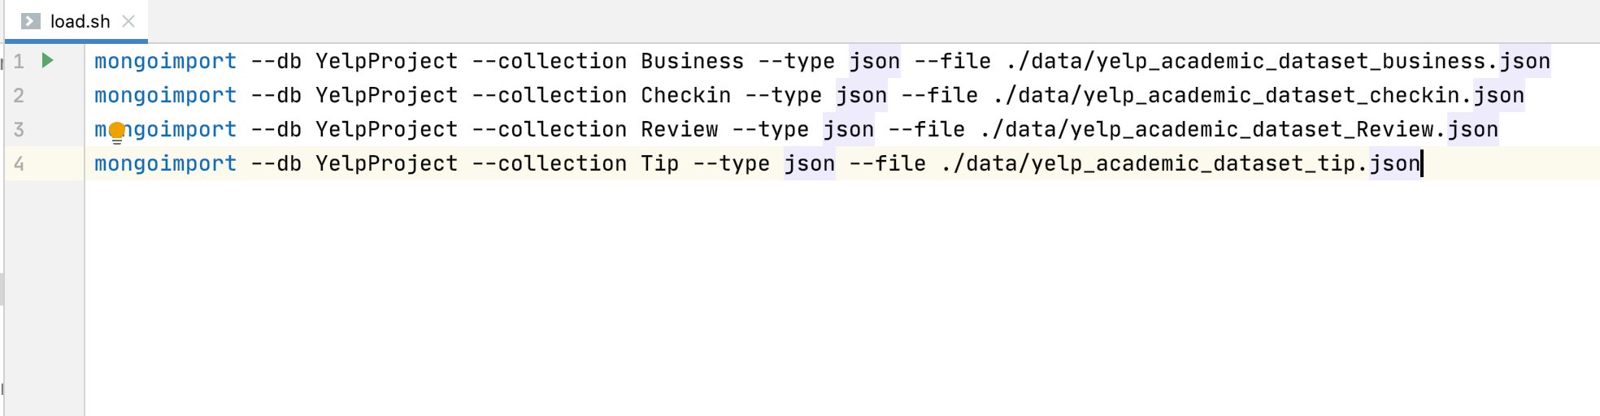
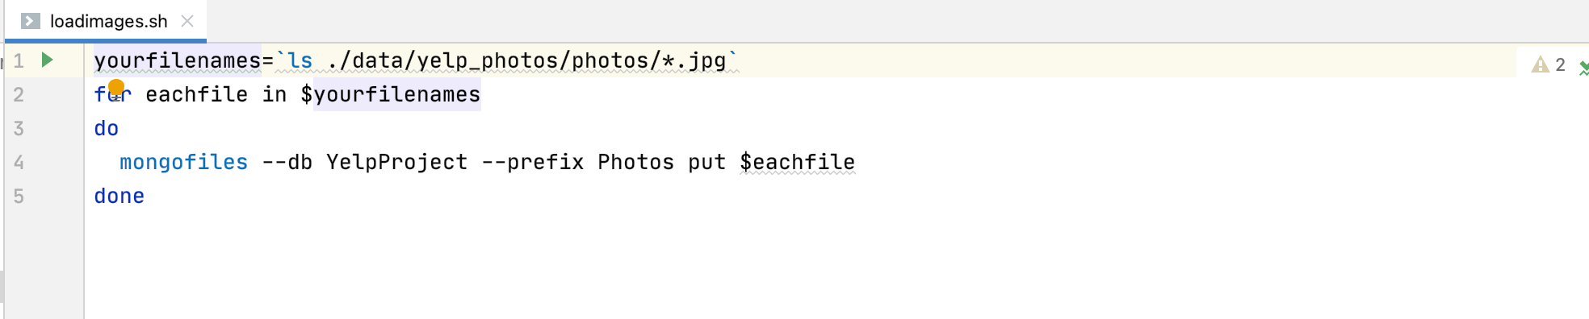
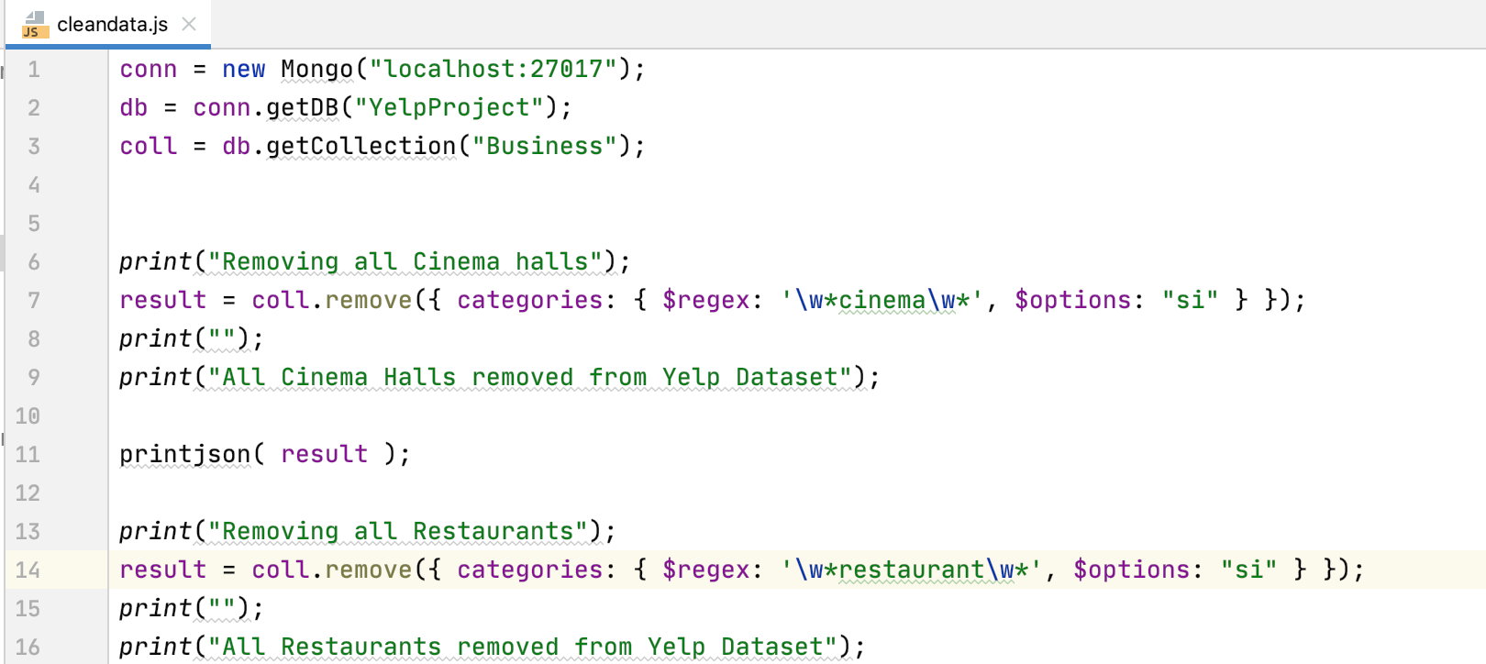
Scripts used to load and clean data

Slide 7
Technologies Used.
We used the MERN stack to create this Web Application.
MongoDB
Express
React
NodeJS

Slide 8
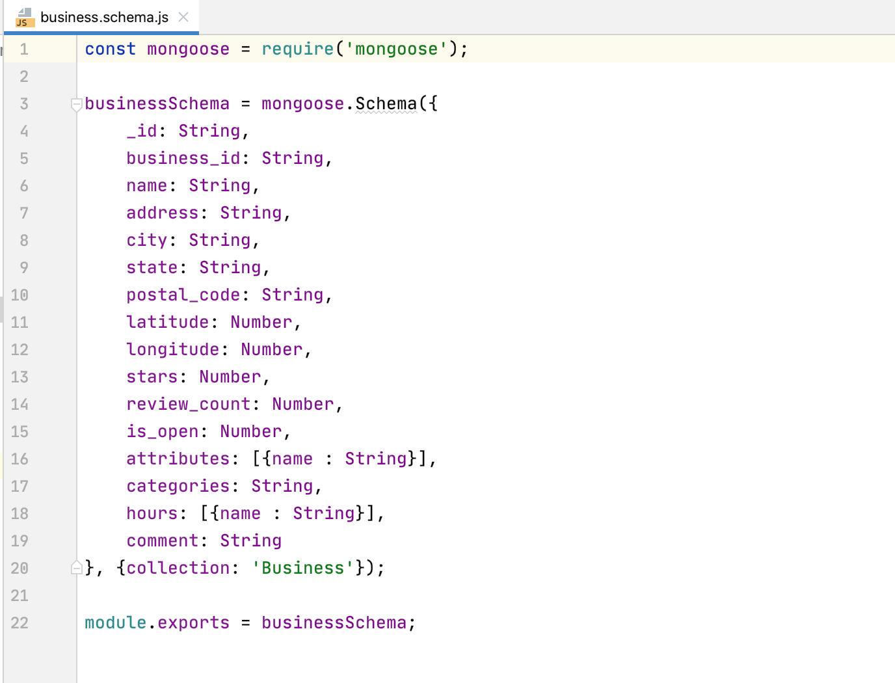
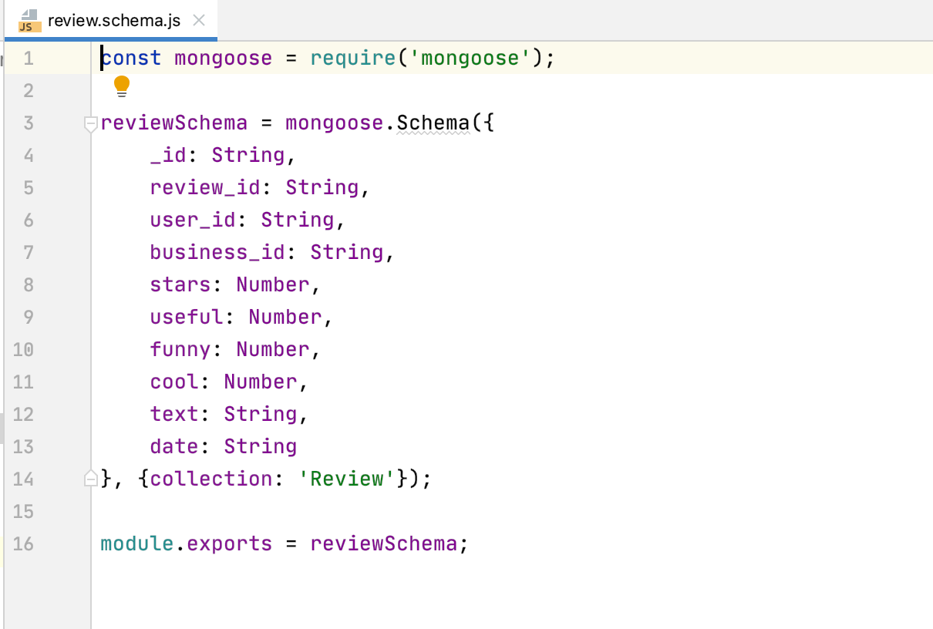
Schema Definition

Slide 9
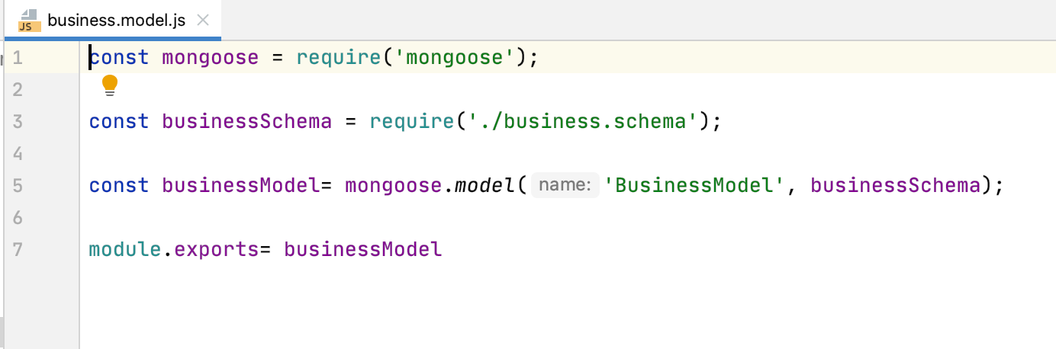
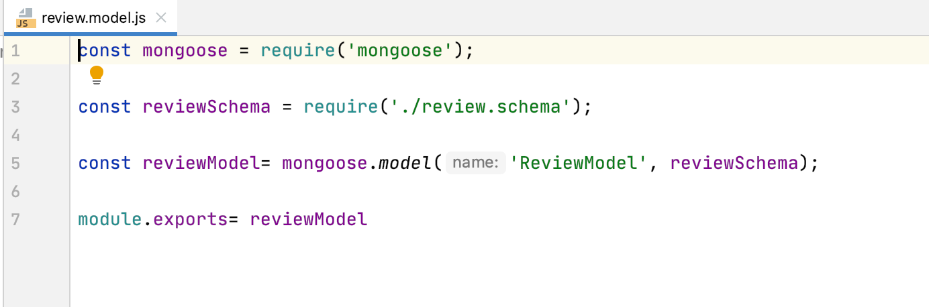
Model Definition

Slide 10
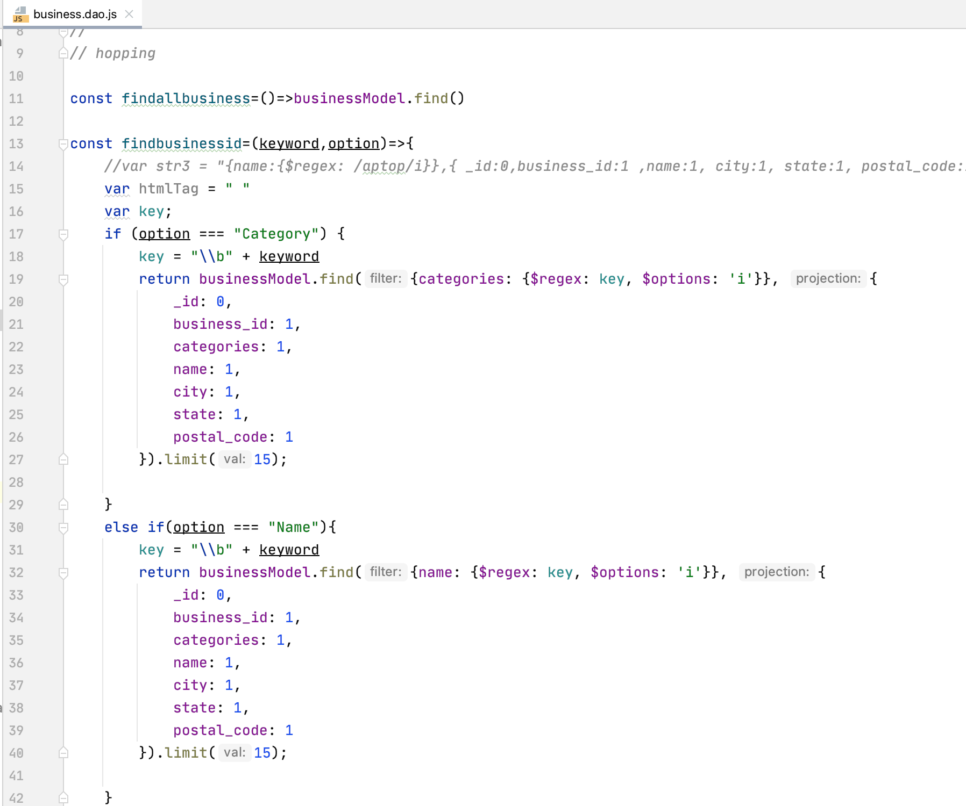
Querying and DAOs.

Slide 11
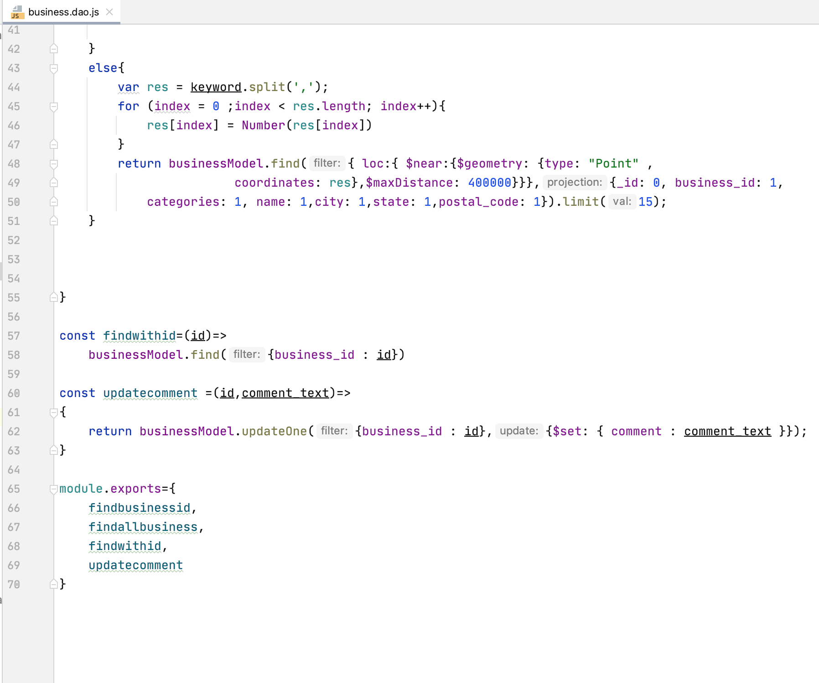
Querying and DAOs Contd.

Slide 12
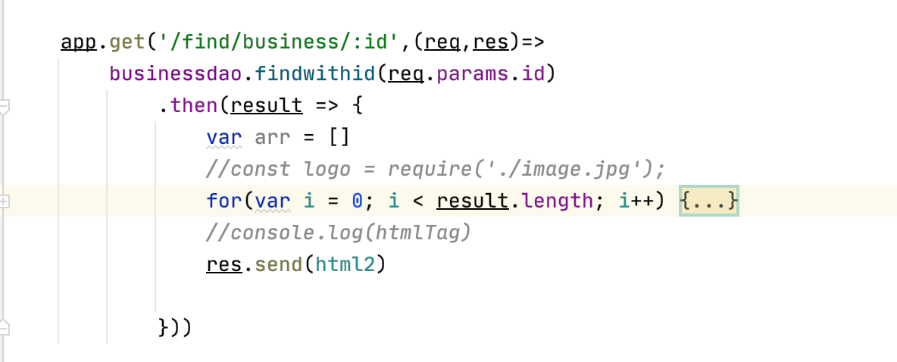
Controllers and Request - Response

Slide 13
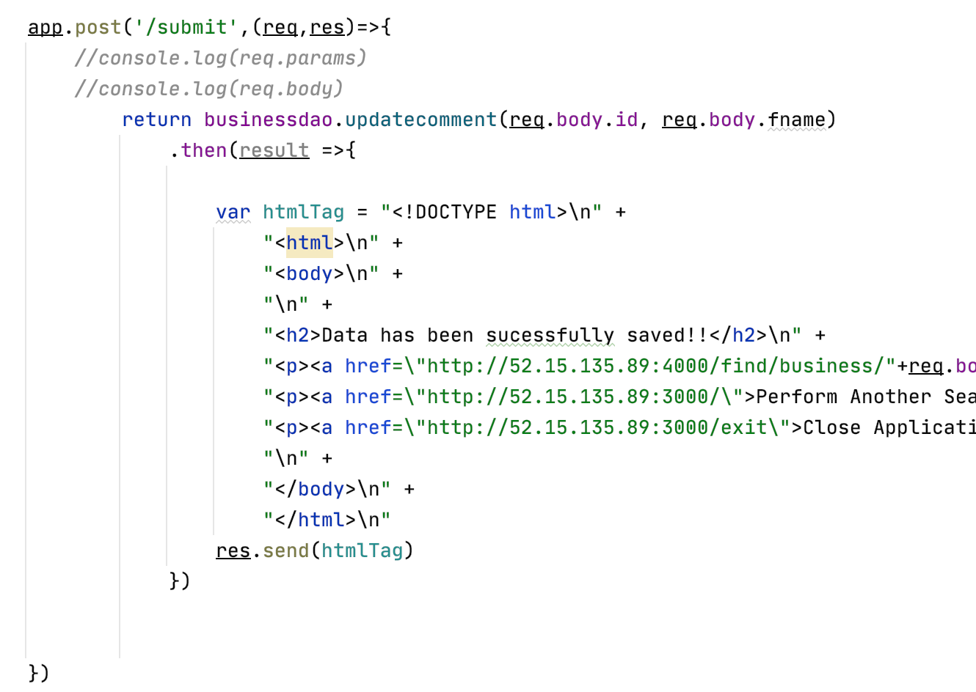
Controllers and Request - Response

Slide 14
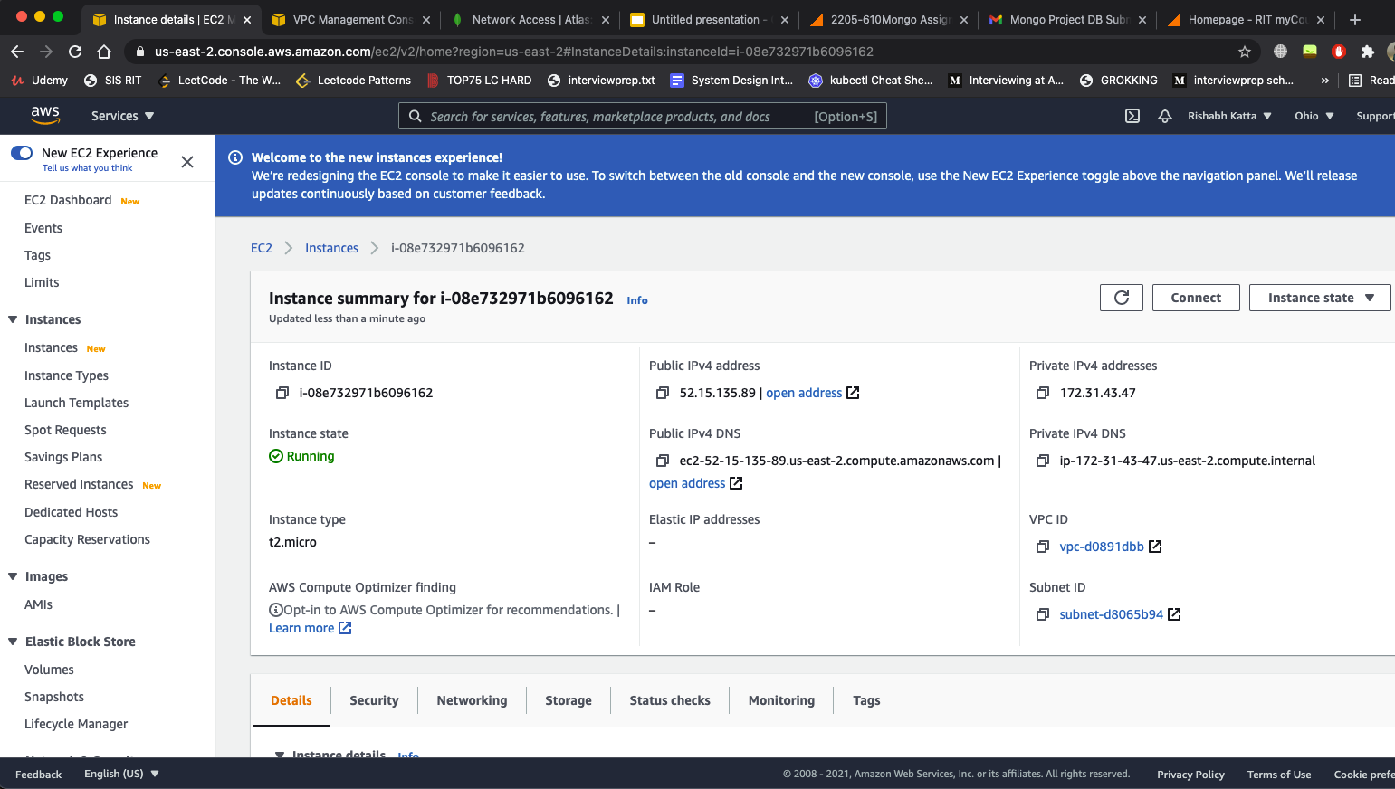
AWS Deployment

Slide 15
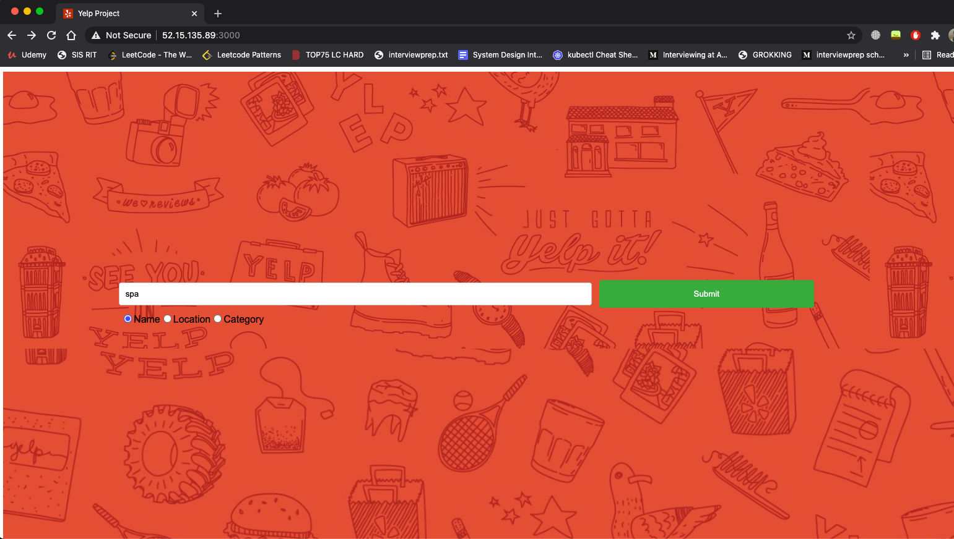
User Interface
1. Search by Name

Slide 16
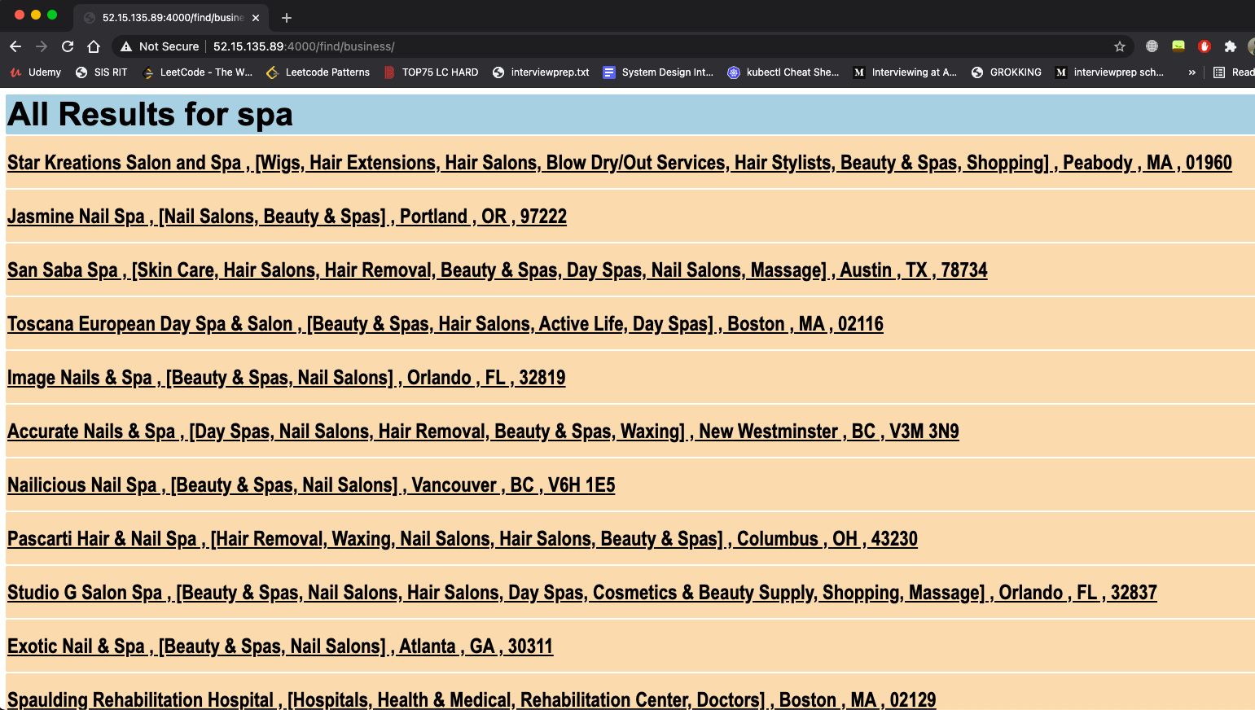
User Interface
1. Search by Name - Results

Slide 17

User Interface
1. Search by Category

Slide 18
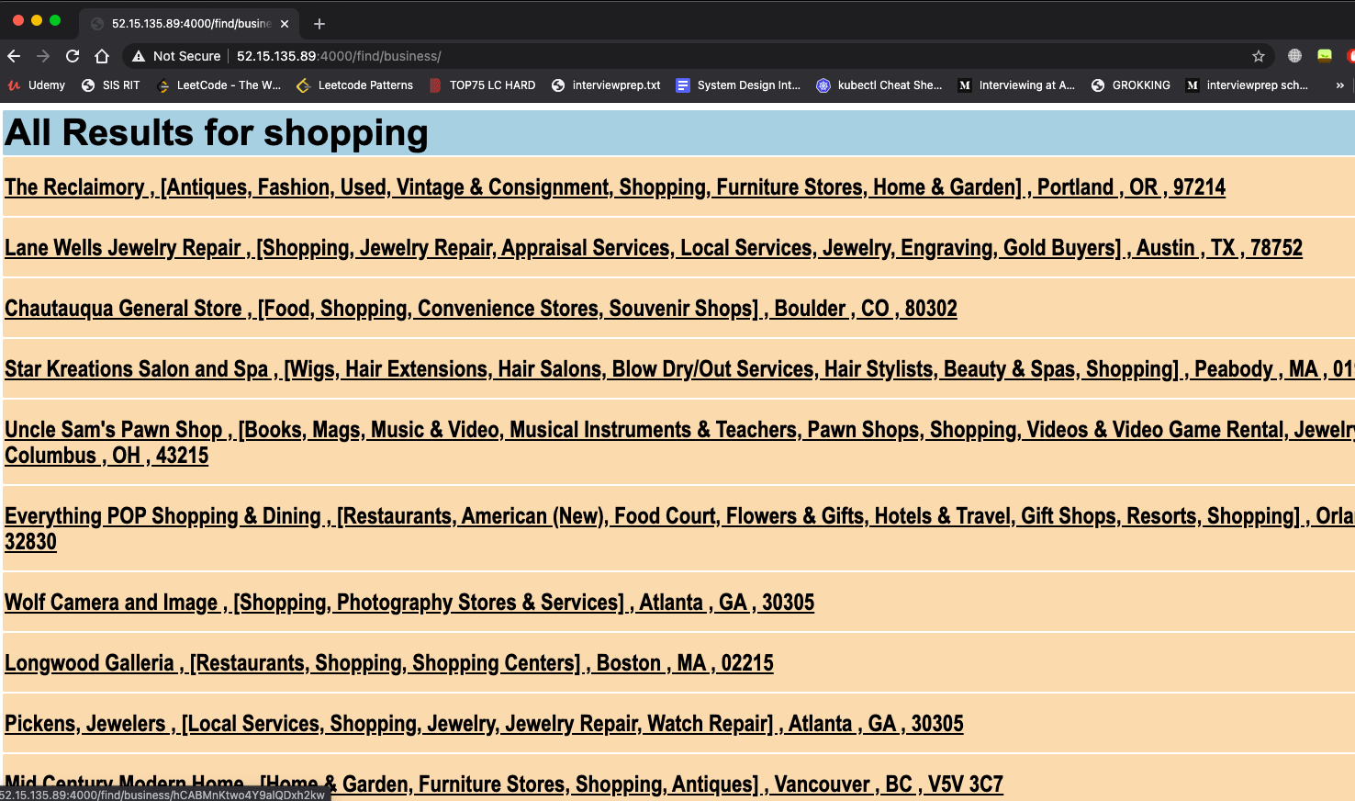
User Interface
1. Search by Category - Results

Slide 19

User Interface
1. Search by Location

Slide 20
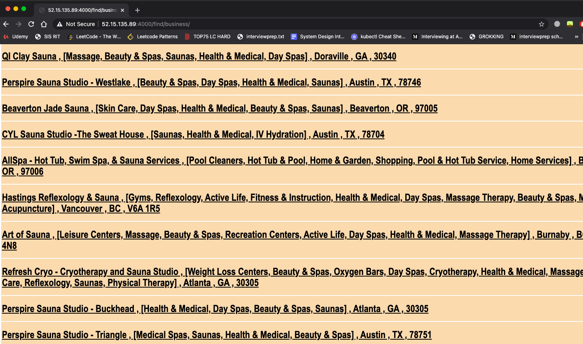
User Interface
1. Search by Location - Results

Slide 21
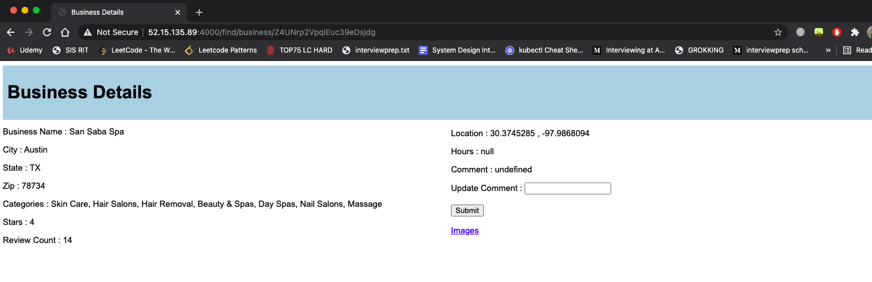
Business details Page

Slide 22
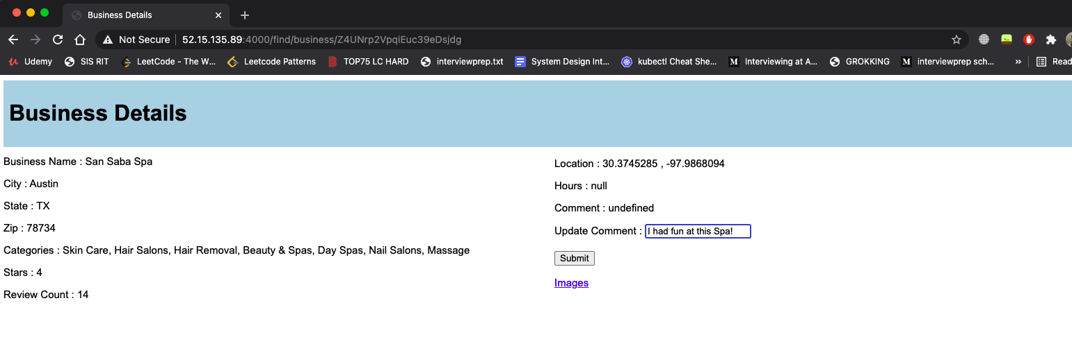
Adding Reviews

Slide 23
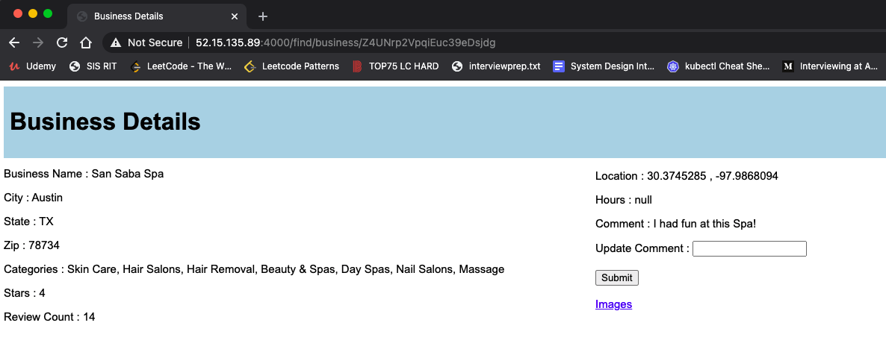
Document with newly added reviews

Slide 24
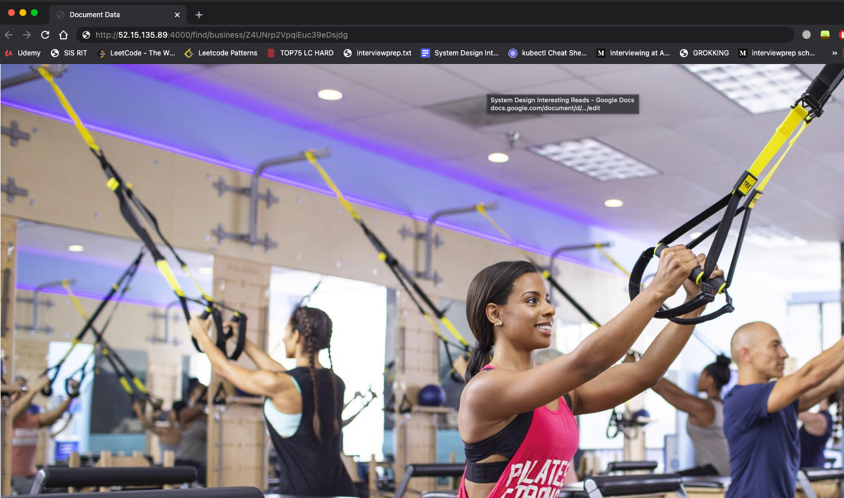
Images of Businesses.

Slide 25
Demo Time!

